Slide 1
D-311 Unit 4: Intelligence

Slide 2
Objectives
Define the difference between information, intelligence, and analysis.
List five sources of information.
Explain how information can be converted to Intelligence.
Describe five ways intelligence is disseminated.
Identify the information sources used to complete an initial ICS-209.
Identify the information used to complete a Unit Situation Report.

Slide 3
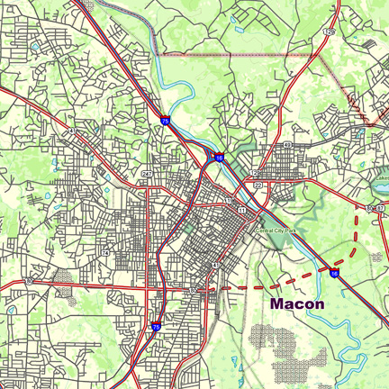
Information
Information is defined as a variety of facts or details.
Information sources:
Manuals and user guides
Operating Plans
Agreements
Radio logs
Maps
And more…

Slide 4
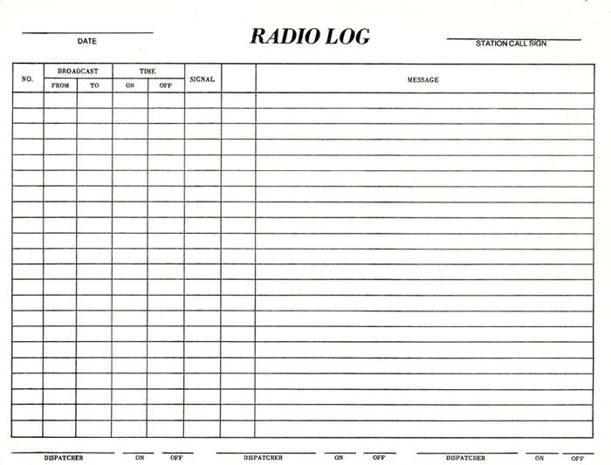
Information Flow
Capture it
Categorize it
Direct it
Document it
Remember what we always say in dispatch: If you don’t write it down, it never happened!
Pass it on

Slide 5
Information Utilization
Required for reports
Prioritizing resource allocation
Others need to know
Helpful for others to know
Can be used to develop intelligence

Slide 6
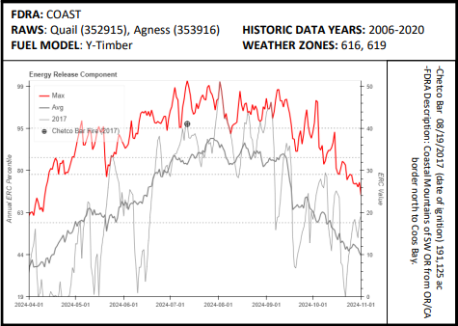
Analysis
Analysis – A process of determining the value and use of information.
Examples:
Long and short term trend analysis
Validation of staffing levels
Current vs. historic conditions (pocket cards)

Slide 7
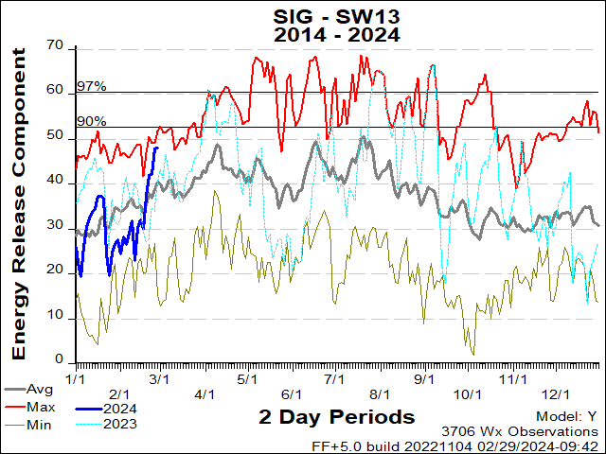
ERC Example
Here is an ERC chart for PSA SW13 including the Cedar RAWS.
If the ERC at Cedar RAWS was 47 last week, is that significant? What about if the ERC was at the 88th percentile?
What is a PSA?

Slide 8
What is Intelligence?
Intelligence - Information that has been analyzed for its application to the current situation.
Why do we need Intelligence?
Examples of Intelligence:
Synopsis of a weather forecast
Resource status
Weekly and monthly outlooks
ICS-209
Interagency Situation Report

Slide 9
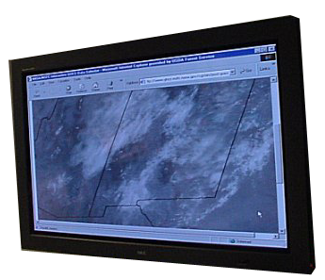
How Information Can Be Converted to Intelligence
Verification
Inconsistent weather indices
Lat/Long
Conflicting reports
Unrealistic time frames
Consolidation
Organizing (eliminating duplication)
Prioritizing
Identifying relevant information
Examples of Information that Should be Converted into Intelligence
Trends
Weather
Resources required
Burning conditions
Safety concerns

Slide 10
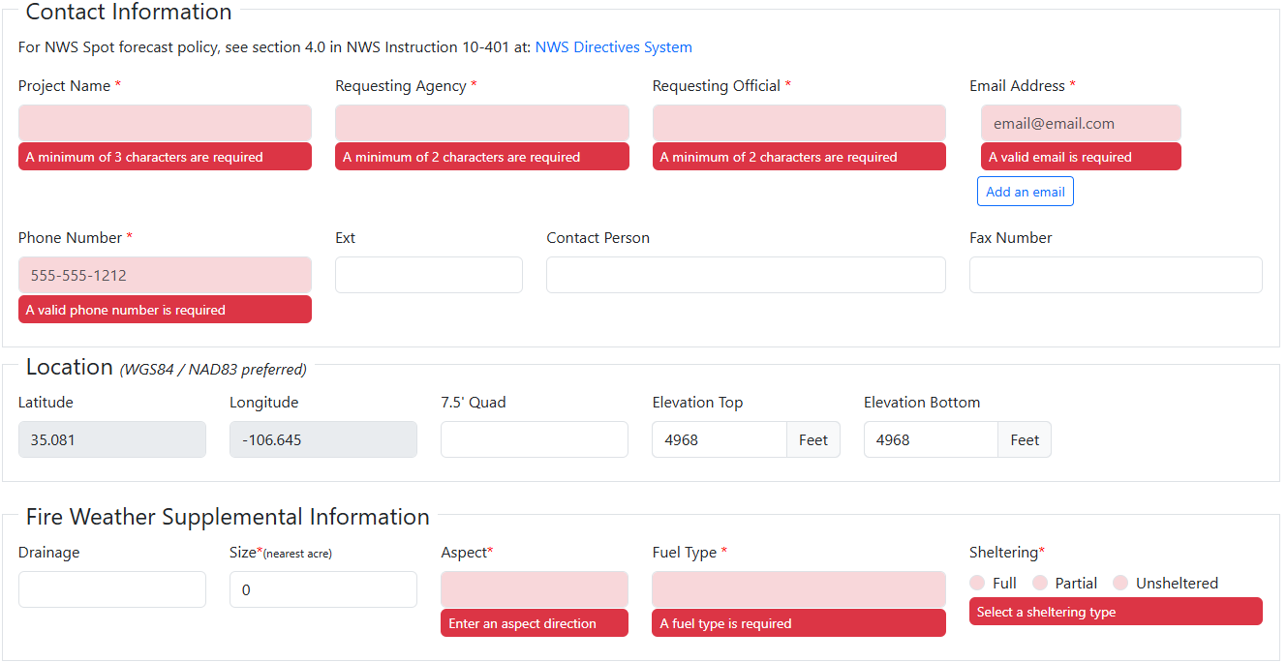
Spot Weather Forecast
Spot Forecasts are a highly localized weather forecast.
Usually requested for incidents that are emerging or already in extended attack.
Required for prescribed burns
New Request page (not depicted)
Set location (lat x long in dD or DMS)
Confirm location on map
Enter incident type and “Generate”
Header information
Entered for a New spot, not follow-up requests
Contact and site conditions
Location information to be specific to the site SPOT is taken for consistent observations

Slide 11
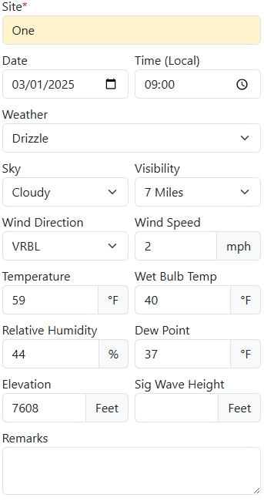
Spot Forecasting
Set a Schedule for Time Covered by the Spot (not pictured)
Three periods going forward from the time selected
Each period is a day or night forecast
For example: submit it to start during the day on Wednesday, can get results for Wednesday day, Wednesday night, and Thursday day
Enter Field Weather Observations
Field resources or RAWS provide these
Multiple observations over time (no closer together than 15-minute intervals but hourly is most common).
Observations Purpose
For New Requests: used to pinpoint the location and weather at the site taken and calibrate what NWS has forecasted to actual field conditions.
For Subsequent Requests: observations are used as feedback to increase accuracy of forecasts and calibrate data.

Slide 12
Spot Exercise
You have an upcoming Rx on your local NPS unit, the Woodsy Piles Rx. The Burn Boss is out making sure the unit will be good to go, expecting a few inches of snow tonight and plan to burn tomorrow. They call into your center to request a Spot Forecast. You have a paper form you can fill out and fax to the NWS
Woodsy Piles Rx requesting spot for all available time frames with the Hysplit. Location is 38°28'19.7"N 107°07'55.6"W. Altitude ranges from 7560-7800ft. In the Gunnison River drainage. 3 acres of piles to burn, south aspect, fuel is piles of tamarisk, no canopy cover.
Weather observations all taken from site 1 @7608 ft are as follows
0900: light fog, partly cloudy, winds 2-5 E, 41°, wetbulb 20°, rh 52%, dp 25°
1000: no weather, scattered clouds, winds light and variable, 43°, wetbulb 19°, rh 37.8%, dp 19%
1100: no weather, clear skies, winds 5-10 NE, 48°, wetbulb 21°, rh 34.1%, dp 21°

Slide 13
Incident Workflow
Incident is reported – “Smoke Check”
Create incident in CAD
Incident is confirmed – “Wildfire”
Enter baseline data and push to IRWIN
Continue making updates in appropriate systems
Get FireCode – its own system, IRWIN has connection to CAD
Create orders in IROC
Update CAD – Not just the Daily Log
Enter ICS-209 if applicable
Close out incident
1) ICS-209 first – enter Ctn/Comp %, mark it Final
2) CAD - follow local procedures, ensuring
Contain, control, and out date and times on Fires Tab
SIT/209 is no longer Authoritative Data Source (ADS)
A Cause is listed
3) Inform - IC/FMO will then certify in InFORM

Slide 14
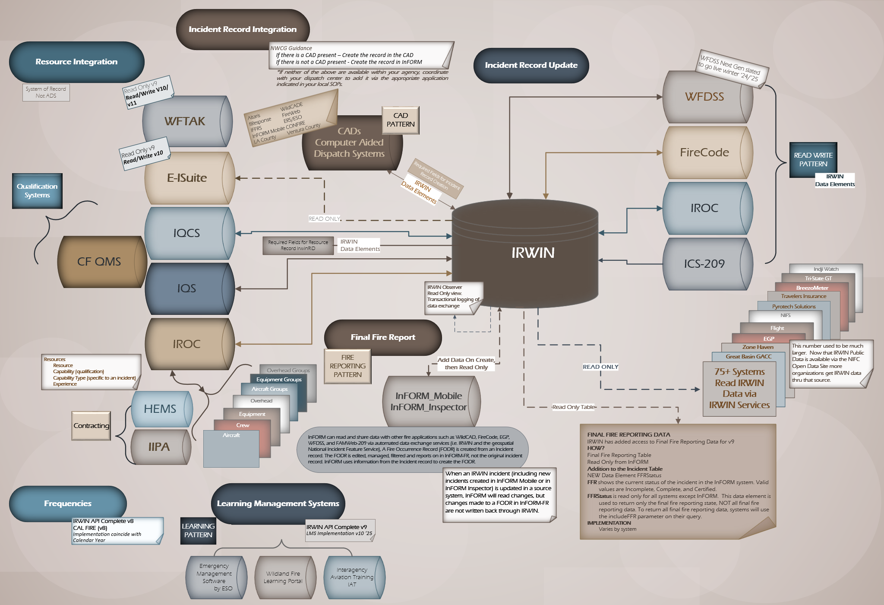
What is IRWIN?

Slide 15
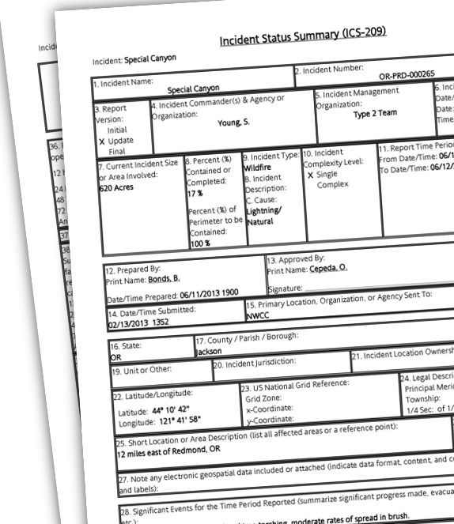
Incident Status Summary ICS-209
The ICS-209 form is a very useful form for communicating Incident Status Information
Submission
SIT 209 system
Paper copies (.pdf)
The Incident Status Summary is a description of what resources are committed, what has been accomplished, and what is anticipated.
It provides specific incident information that is used at all levels of the dispatch and coordination system.

Slide 16
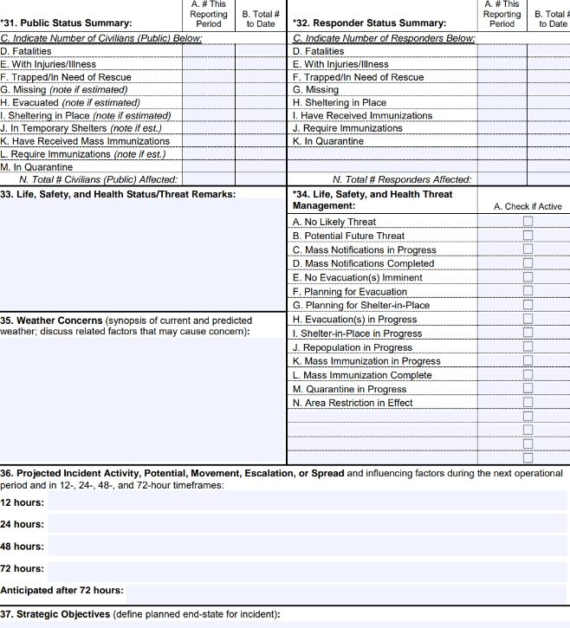
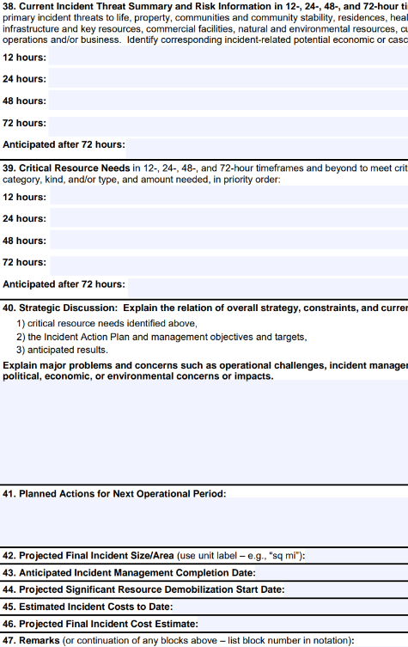
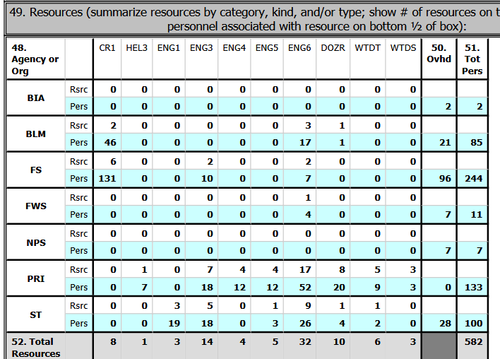
ICS-209 Data Entry

Slide 17
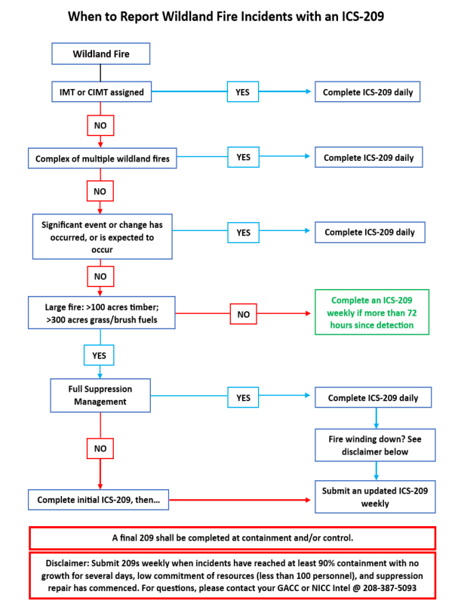
Does My Fire Require a 209?
An ICS-209 needs to be completed daily if:
There is an IMT of Type 1, 2, or Complex
The incident is a complex of multiple fires
Significant event or change has occurred or is expected to occur
Fire meets size requirements with a full suppression strategy
An ICS-209 needs weekly completion if:
Fire meets size requirements and is not Full Suppression
When the fire is contained or controlled a final ICS-209 needs to be submitted – before the incident is closed in CAD or InFORM

Slide 18
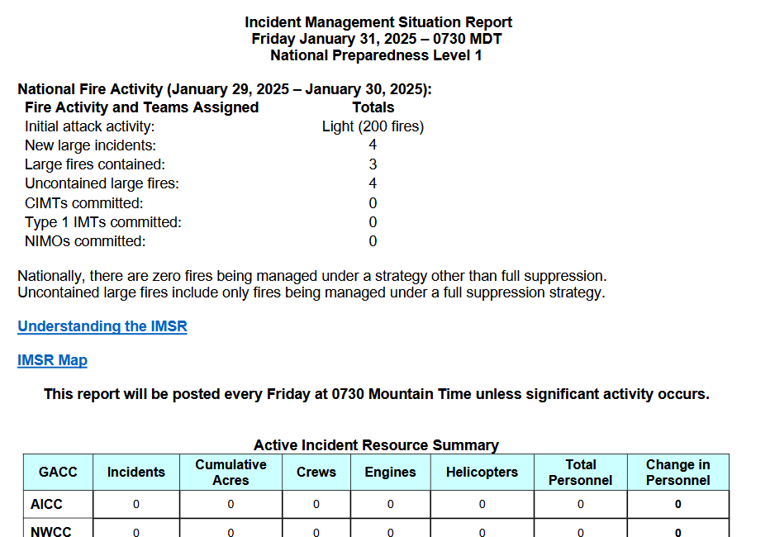
SIT & IMSR
Interagency Situation Report
While the 209 gives specifics about one incident, the SIT gives an overall picture of fire activity and resource commitment for new emerging fires as well as large fires by dispatch center
It also shows year to date statistics for wildland fires and RX fires.
Interagency Management Situation Report IMSR or SIT
This national report is a compilation of the situation report and the ICS-209s from all dispatch centers across the country.

Slide 19
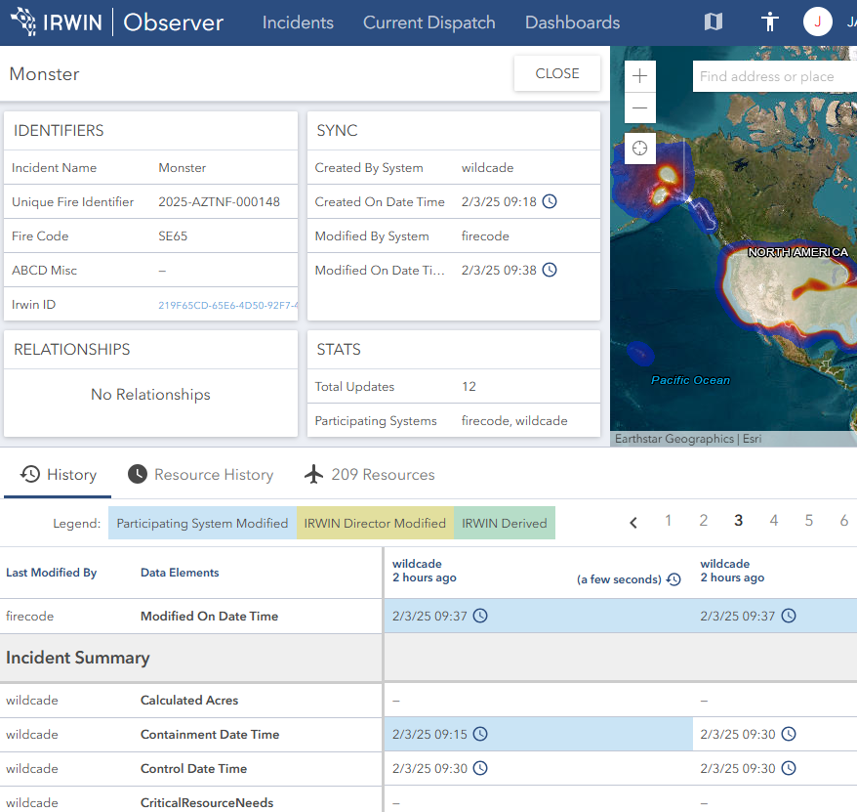
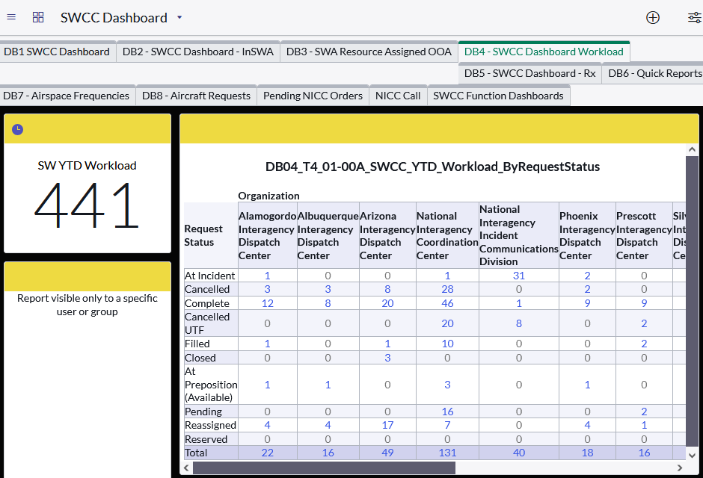
IRWIN Observer & IROC
Show all IRWIN data regarding an incident
Doesn’t include information that doesn’t go to IRWIN, such as the CAD logs, or timers.
See when incident was modified and by what system and user.
Troubleshooting.
Intelligence is focused on overall workload
Volume of resource orders
National mobilizations
Reporting
Dashboards

Slide 20
EGP & Weather Systems
EGP has many map layers available including:
Heat detection
See IR flights
Current incident perimeters
Resource tracking
Not just mapping, can develop modules, such as Flight which is used to track retardant costs at tanker bases.
Lightning maps
EGP is the official source, but there are other resources available
LightningMaps.org / Blitzortung
EarthNetworks
WIMS – Weather Information Management System
Will be going away as the new programs get up to speed
Access weather data and manage RAWS stations
FEMS – Fire Environment Mapping System
Visual Representation of observed and forecasted weather.
Contains Fuel Moisture Data, such as that which used to be housed in the National Fuel Moisture Database.
WXx – Weather Module
New location to manage the RAWS.

Slide 21
Intelligence Gathering Exercise
You’ve come back to the IA office from lunch at 14:35. The Initial Attack Office is a Zone Dispatch in Southeast Arizona. The FMO is Louie Pope, and he is currently walking up to Silver Peak Lookout near the center of the forest. The other IA dispatcher you are working with is Sandy Nelson. She is currently entering data on the computer and is on the phone. See the following log and answer the questions as they relate to Intelligence.

Slide 22
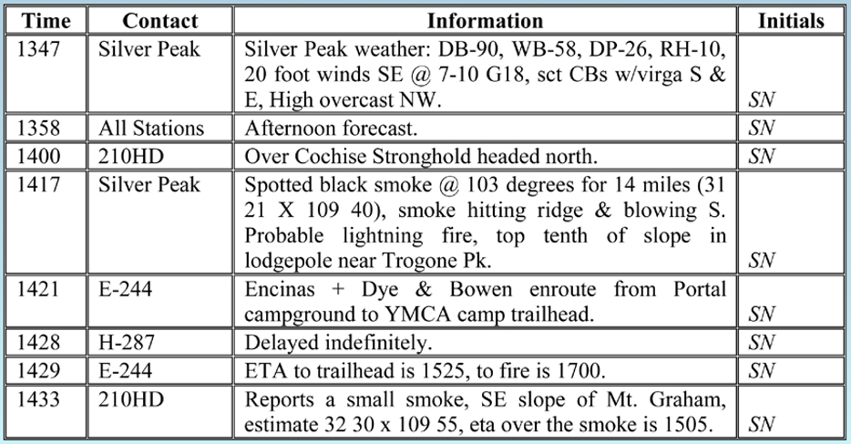
Exercise Continued
What three pieces of information are the most important?
What other information would be helpful for making decisions?
What can you deduce from the information?
The FMO calls in and wants an analysis of the situation. What do you tell him?

